Slide 1


INTEGRATED PROJECT – SUMMER 2024
Exploratory Data Analysis (EDA), Statement of Work
Team Arocha
Actuarial Science Program
June 3, 2024

Slide 2
TABLE OF CONTENTS
01 | What is EDA?
02 | Steps in EDA
03 | Data Visualization
04 | Statement of Work

Slide 4
What is EDA and Why it is Important?
EDA is the process of analyzing data sets to summarize its features, often using visuals
Helps in making informed decisions about the data preprocessing and feature selection
Identifies relationships between variables
Detects outliers and anomalies
Provides insights that guide further analysis

Slide 5



Steps in EDA
1 Data Collection
Sources: csv, xlsx, databases, etc.
Tools: Python libraries (pandas, numpy)
2 Data Cleaning
Handling missing values
Dealing with outliers
Correcting data types
Removing duplicates
3 Data Transformation
Normalizing and scaling
Encoding categorical variables
Feature engineering

Slide 6
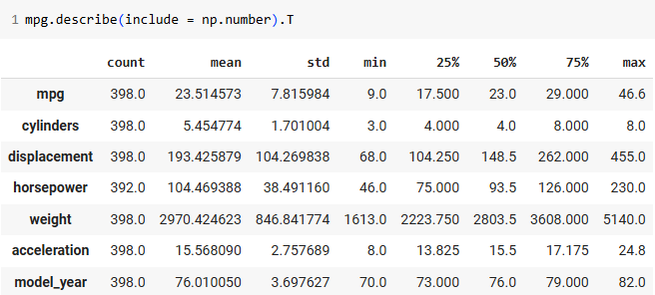
Descriptive Statistics
For example, numerical features of the mpg dataset:
But also consider the interquartal range (IQR), i.e., boxplots, and density plots

Slide 7
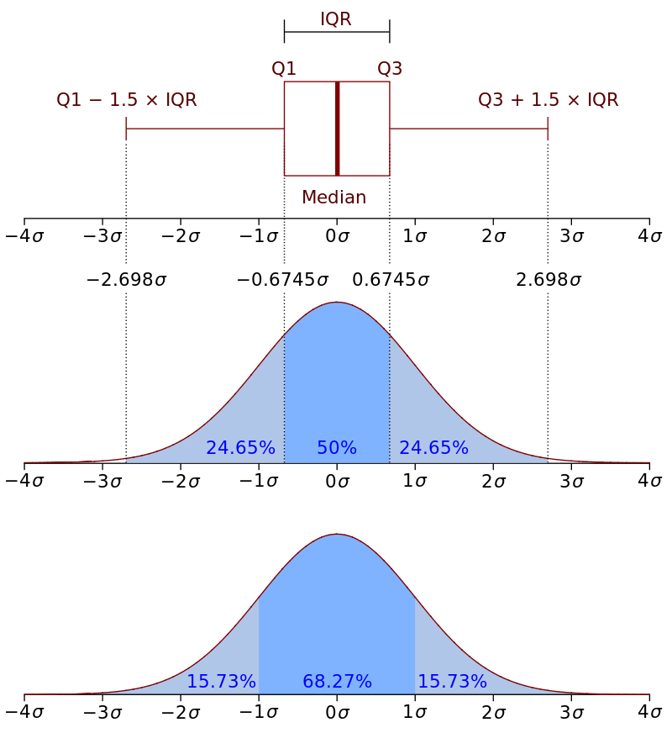
IQR for a Standard Normal Distribution

Slide 8



Data Visualization
1 Univariate Analysis
Boxplot and histogram (incl. density) for each numerical variable
Countplots for each categorical variable
Avoid pie charts!
2 Bivariate Analysis
Scatterplots, boxplots
Linear correlations
3 Multivariate Analysis
Pairplots, heatmaps
Avoid 3D plots!

Slide 9
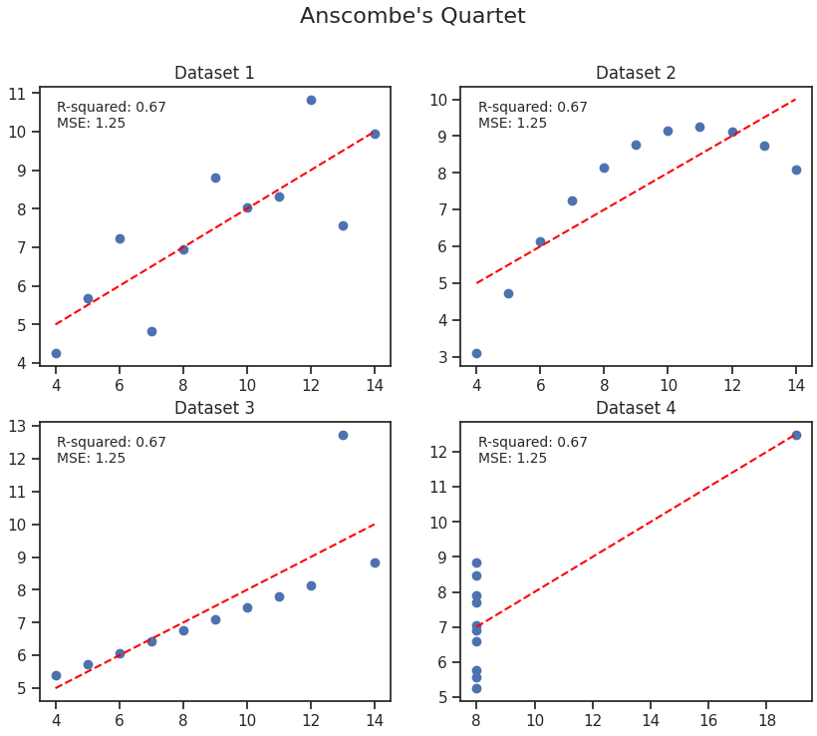
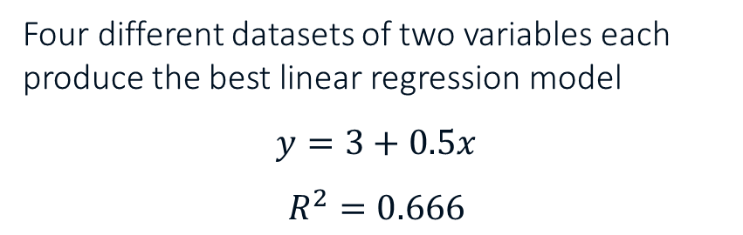
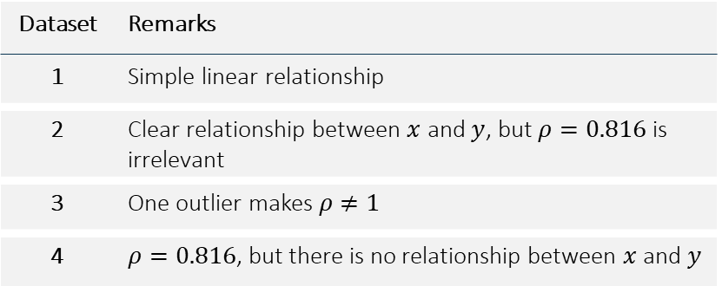
The Importance of Visualizing
Four different datasets of two variables each produce the best linear regression model
$$y=3+0.5x$$
$$R^{2}=0.666$$
Dataset | Remarks
1 | Simple linear relationship
2 | Clear relationship between $x$ and $y$, but $ρ=0.816$ is irrelevant
3 | One outlier makes $ρ≠1$
4 | $ρ=0.816$, but there is no relationship between $x$ and $y$

Slide 10
Statement of Work
For the first draft, create a 2—3 page document with the following content
For the final version, include a detailed timetable
Component | Description | Best Practice
Project title | Descriptive name | Make it concise, yet descriptive
List of members and contact information | Contact data of team members, instructors, and mentor | Use a tabular format
Introduction | Business problem that your client wants to solve | 1—2 short paragraphs
Objective | High-level description of project and how will project help the client (i.e., “Columbia Insurance Company”, or CIC) to solve the problem | 2—3 short paragraphs outlining the purpose of the project
Scope of services | List of all major steps that you will perform, including with the data that is required from CIC | Bulleted lists: one for the steps, another for the required data
Handling of proprietary information | A statement guaranteeing the confidentiality of the data | Start with “Our consultancy undertakes to maintain stringent secrecy and not to disclose to any third parties, during the lifetime of the project and after the project has ended, any documents or information related to CIC”
Proposed learning outcomes | What will you learn by undertaking this project | Start with “After the successful completion of this project, the members of our team will be able to ...”

